Slide 1
AICTE IBM PROJECT AGENTIC CAREER COUNSELING
COMPANION
Presented By:
Name : Yarramsetty Geyasree
College Name : Tirumala Engineering College Department : Information Technology

Slide 2
OUTLINE
Problem Statement
Technology used
IBM cloud services used
Project Description
Proposed Solution
API Reference
System Approach
Result
Conclusion
Git-hub Link
Future Scope
IBM Certifications

Slide 3
PROBLEM STATEMENT
An AI Agent for Digital Financial Literacy, powered by RAG (Retrieval-Augmented Generation), helps users understand and navigate essential financial tools and practices. It retrieves reliable content on using UPI, avoiding online scams, understanding interest rates, budgeting, and personal finance management from government portals, banking websites, and educational platforms. With multilingual support, users from diverse backgrounds can interact in their preferred language and ask questions like “How do I send money via UPI?” or “What is a safe interest rate for a loan?” The agent ensures financial literacy is accessible, personalized, and culturally inclusive. This AI-driven assistant empowers users with knowledge, protects them from fraud, and builds confidence in digital finance.

Slide 4
TECHNOLOGY USED
IBM cloud lite services
Natural Language Processing (NLP) Retrieval Augmented Generation (RAG) IBM Granite model

Slide 5
IBM CLOUD SERVICES USED
IBM Cloud Watsonx AI Studio
IBM Cloud Watsonx AI runtime
IBM Cloud Watson AI Machine Learning
IBM Cloud Agent Lab
IBM Granite foundation model

Slide 6
PROJECT DESCRIPTION
An AI Agent for Digital Financial Literacy, powered by RAG (Retrieval-Augmented Generation), helps users understand and navigate essential financial tools and practices. It retrieves reliable content on using UPI, avoiding online scams, understanding interest rates, budgeting, and personal finance management from government portals, banking websites, and educational platforms. With multilingual support, users from diverse backgrounds can interact in their preferred language and ask questions like “How do I send money via UPI?” or “What is a safe interest rate for a loan?” The agent ensures financial literacy is accessible, personalized, and culturally inclusive. This AI-driven assistant empowers users with knowledge, protects them from fraud, and builds confidence in digital finance.

Slide 7
PROPOSED SOLUTION
The proposed system The proposed system ama to guide students in choosing the most suitable caner putha by analyzing ther academic avam, nterests and year of study. The solution uses M Watson Assistant to crates mart, interactive chatbot that a fhers personalized suggestions
Data Collection :
Used a predefined dataset mapping branch, interest, and year to career options.
Future scope includes using academic performance and resume data.
Data Preprocessing :
Created interns and entities (@tiranch @ysur &@entities) for accurate input handling.
Mandantory and input salum for better recognition.
Chatbot Logic :
Designed a structured flow using Watson Assistant guidance
Deployment :
Deployed Watsonxai Studio
Accessible through web-based preview and ready for future integration
Evaluation :
Tested for a mouth flow tent accuracy, and response quality.
Heipe student explore careers, skills, and courses interactivity.
Result:
Delivered a working career counselling assistant. Hope students explore careers, skills, and courses interactively

Slide 8
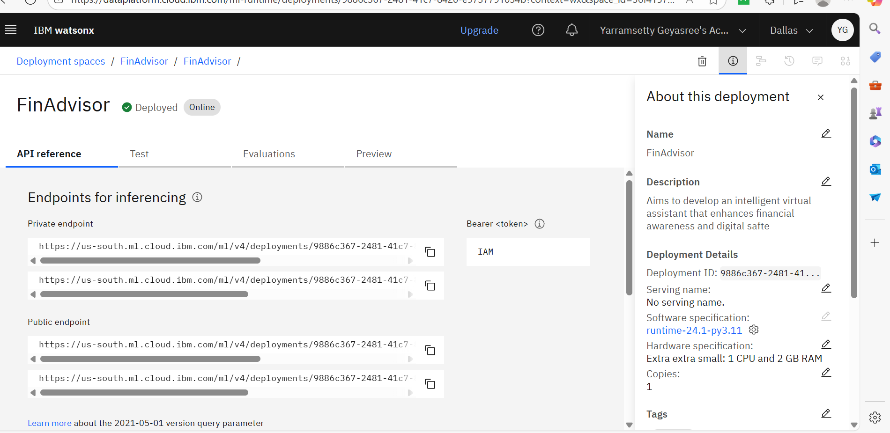
API REFERENCE

Slide 9
SYSTEM APPROACH
The "System Approach" section outlines the overall strategy and methodology for developing and implementing the Al-based Career Counsellor Bot using IBM Watson Assistant. It focuses on the platform setup, tools used, and logical design behind the chatbot's functioning.
System requirements: IBM cloud with Watsonx.al and Watson Assistant access.
Library required to build the model: IBM Watson Assistant (Dialog Skill) for conversation flow

Slide 10
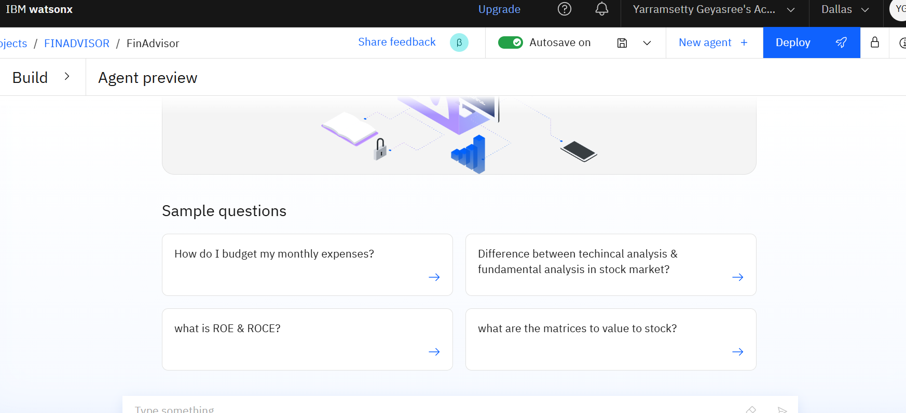
BUILDING

Slide 11
END USERS
Everyday consumers learning digital finance
Non-English speakers and low-literacy users
Students and young adults managing money
Senior citizens using online financial tools

Slide 12
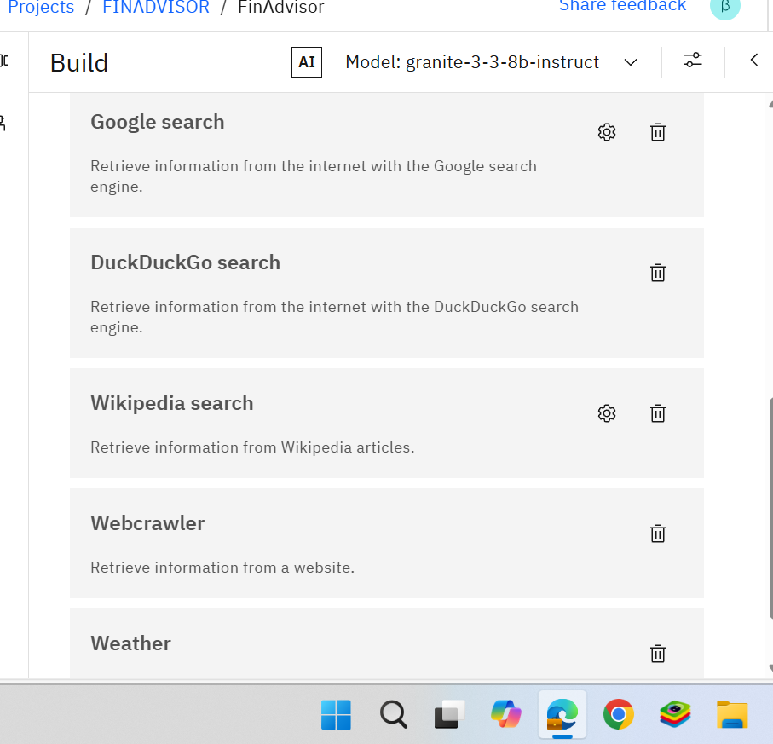
RESULTS

Slide 13
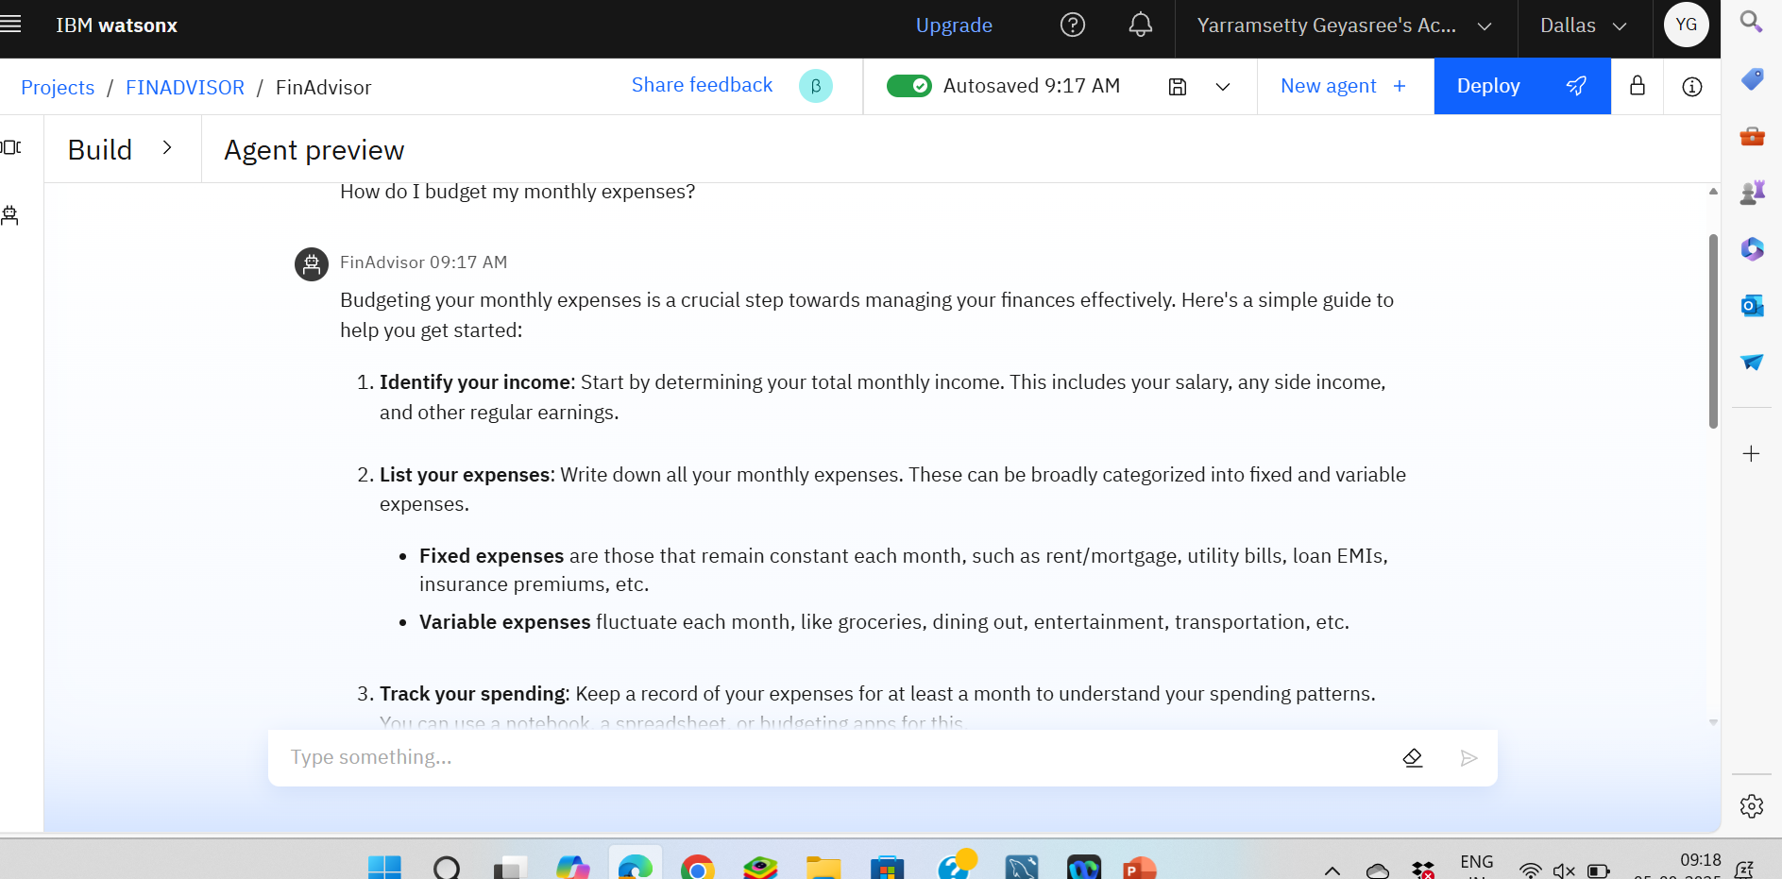
RESULTS
Agent Preview

Slide 14
CONCLUSION
In conclusion, the AI Agent for Digital Financial Literacy powered by RAG represents a significant step toward making financial education accessible, personalized, and inclusive for all. By leveraging reliable sources and supporting multiple languages, this intelligent assistant addresses critical gaps in digital financial knowledge and empowers users to navigate complex financial tools safely and confidently. Ultimately, this project contributes to building a more financially aware and secure society, reducing the risks of fraud, and fostering greater participation in the digital economy.

Slide 15
GITHUB LINK
Github Link: https://github.com/Geya123/FinAdvisor

Slide 16
FUTURE SCOPE
Integration with banking APIs for personalized advice
Expansion to voice assistant platforms
Advanced AI-driven fraud detection alerts
Gamified financial literacy learning modules
Support for regional dialects and offline access

Slide 17
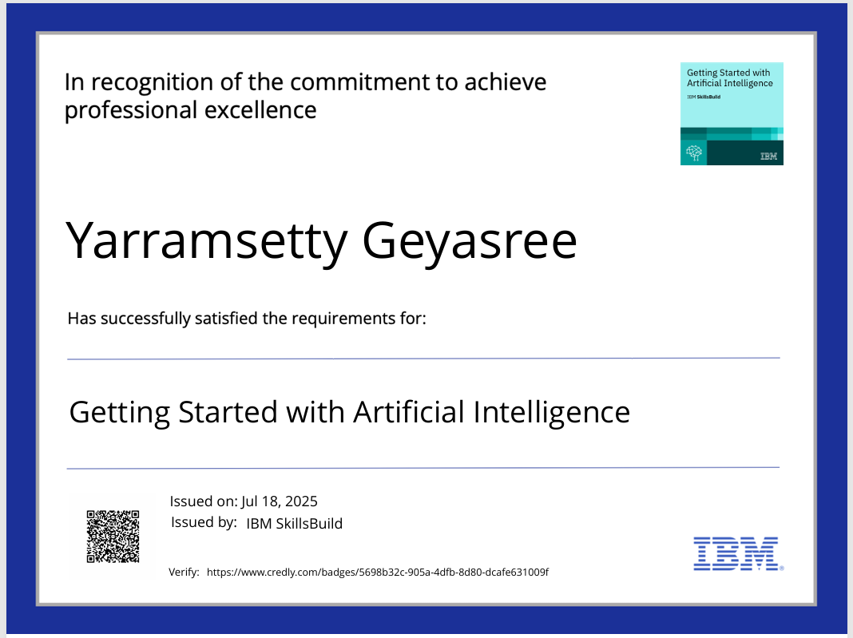
IBM CERTIFICATIONS
Screenshot/ credly certificate( getting started with AI)

Slide 18
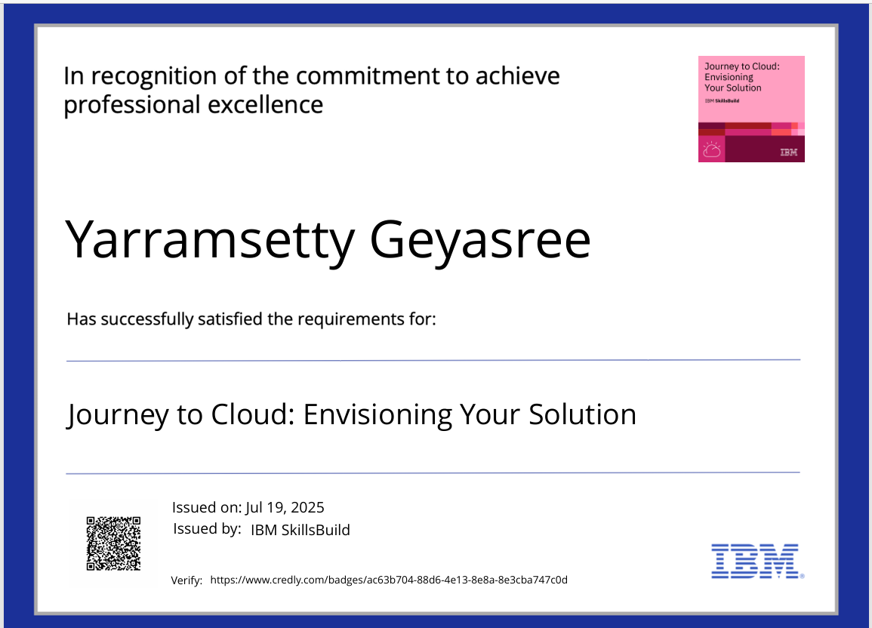
IBM CERTIFICATIONS

Slide 19
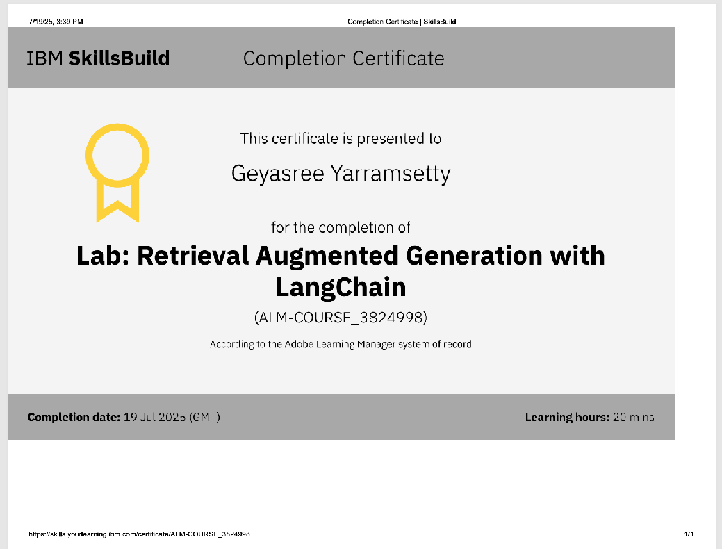
IBM CERTIFICATIONS

Slide 20
THANK YOU

